Slide 1

Node.js as a Unix-based Application:
Nikita Niakhai/M25-SNE-01/Unix-based Applications
Abstract: Node.js — a Unix-focused, event-driven runtime built on V8 and libuv—uses non-blocking I/O and OS-level primitives (epoll/kqueue) to sustain high concurrency with low resource cost. This report analyzes its architectural foundations, performance behavior as documented in peer-reviewed systems research, and security posture shaped by modern vulnerability studies. It also highlights key limitations, including CPU-bound stalls and module-system complexity, and outlines future directions amid emerging runtimes such as Deno and Bun.
Evolution, Architecture, Performance, Security

Slide 2


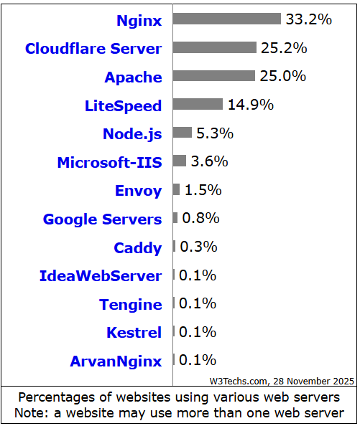

Introduction. Definition
Introduction
Node.js – is a free, open-source, cross-platform JavaScript runtime environment that lets developers create servers, web apps, command line tools and scripts.
Currently Node.js is one of the most popular (5th place) open source web server on the Internet.
One language for frontend and backend (C/S)
Overcoming Blocking I/O Limitations (Apache ☹)
High concurrency (C10k → C100k)
V8 JS engine appeared
real use cases — edge, IoT, API gateways, streaming — that need efficient, well-engineered JS runtimes on Unix.
[01] https://w3techs.com/technologies/overview/web_server
[02] https://nodejs.org/en

Slide 3

Evolution of Node.js
Evolution. Timeline.
2009
2010-2014
2019
2020s
Ryan Dahl creates Node.js at Joyent, focusing on event-driven I/O for Unix centric runtime for creating web-servers
Early adoption for high-performance networks;
Foundation formed for governance
Merges into OpenJS Foundation for open-source collaboration
V8/JIT improvements, worker threads, ESM maturation, ecosystem growth

Slide 4
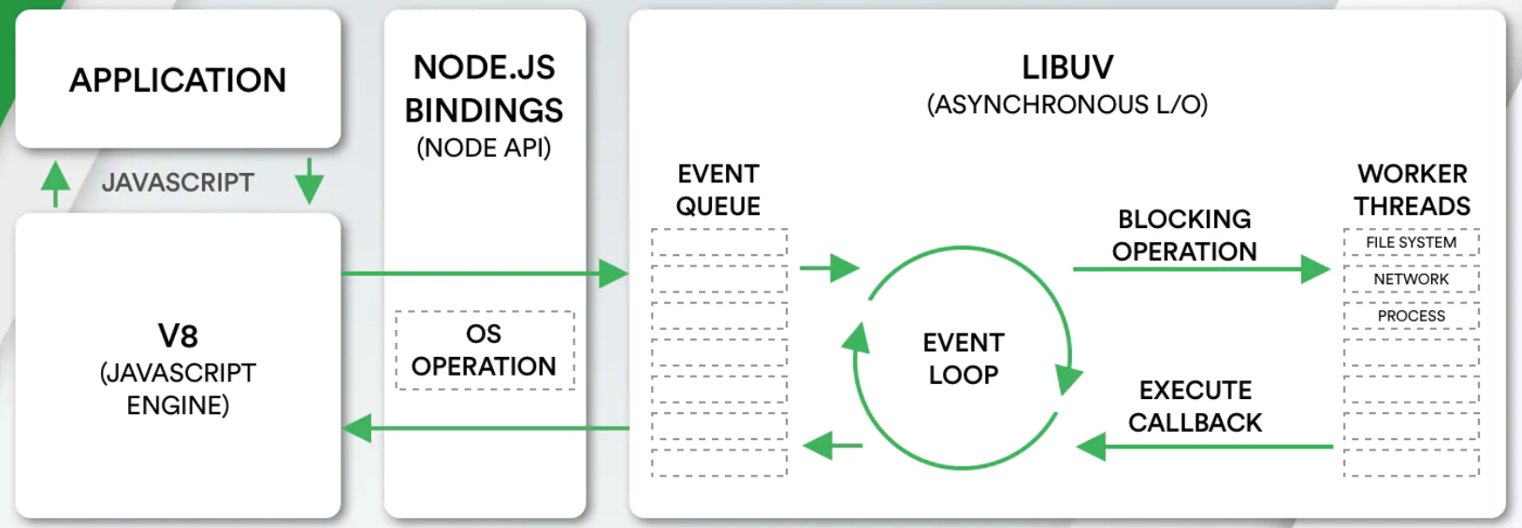

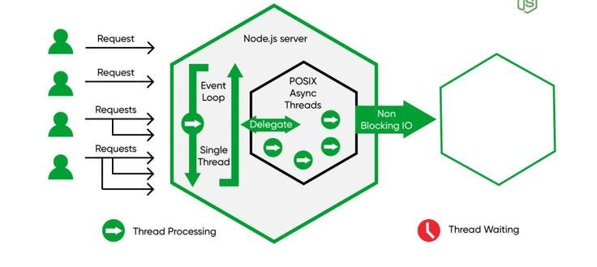
Figures. Diagrams of node.js architecture
High-level Process Model

Slide 5
High-level Process Model
Main process
Event loop integration
Clustering
High-level Process Model
Single-threaded event loop for I/O operations
Master process spawns workers for multi-core utilization
Handles callbacks, timers, pending I/O
Privilege separation
Hot reloading
Workers run with limited privileges
Dynamic updates via cluster restart mechanisms

Slide 6
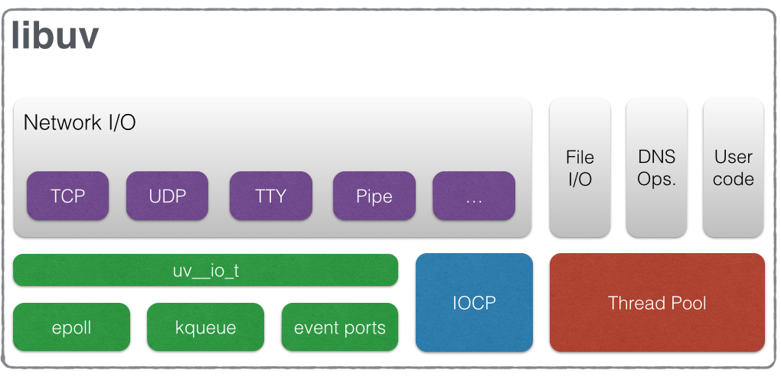
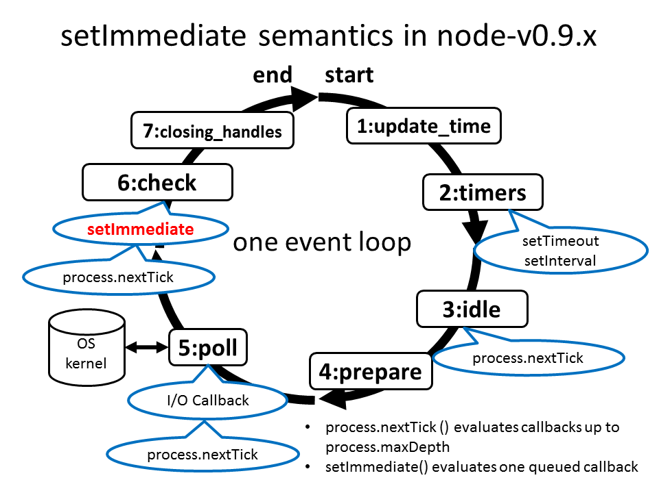
Figure 1. Of libuv architecture
Event-driven Architecture Deep Dive – Part 1
Figure 2. Of libuv event loop
libuv
Asynchronous I/O
Non-blocking everywhere
Cross-platform abstraction for asynchronous I/O
Non-blocking reads/writes using Unix callbacks
Avoids thread blocking for scalability

Slide 7
Minimizes data copying with sendfile
Event-driven Architecture Deep Dive – Part 2
Unix syscalls
Zero-copy I/O
epoll (Linux), kqueue (BSD) for efficient event notification
process.nextTick
Cluster module
Microtask queue for immediate execution
IPC for shared memory, load balancing
Optimizations
SharedArrayBuffer for inter-worker communication

Slide 8
Node.js keeps latency steady and predictable—even when overloaded—while pushing high throughput. In contrast, threaded systems can spike in wait times or crash. This is huge for real-world apps like e-commerce sites during sales
Performance Advantages on Unix Systems
C10K+
Event-driven vs Thread
Studies show SPED servers (like node.js/nginx) outperform thread-/process-based servers on in-memory workloads, scale better, has lower overhead
can handle tens of thousands of clients on modest hardware
Predictable latency, high throughput under overload
Clustering extends single-thread benefits
"clustering"—creating a team of worker processes that share the load. It's like one boss (master process) delegating to helpers on Unix, extending the perks of being lightweight while handling more work without the mess of full threading

Slide 9
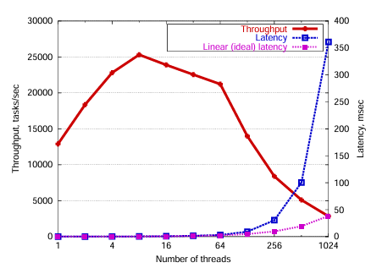
Performance Advantages on Unix Systems. Part 1
At first, speed (throughput) goes up, but then it peaks and crashes hard, while wait times (latency) explode—like a highway jamming up in rush hour. Event-driven systems (like Node.js) don't do this; they stay steady.
Figure 1. Throughput and latency degradation in threaded servers under increasing load
[1]

Slide 10
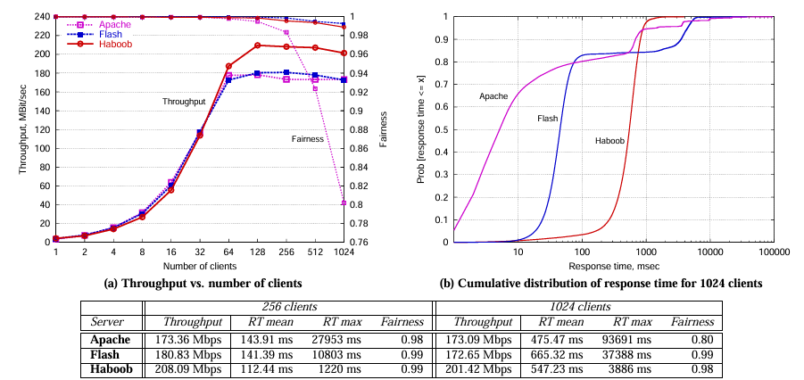
Performance Advantages on Unix Systems. Part 1.1
Comparison of an event-driven server (Haboob, based on SEDA tech that's similar to Node.js) to a threaded one (Apache, an old-school web server). The event-driven one keeps pumping out data at over 200 Mbps (megabits per second) even with 1,000+ users, and it's "fair" (treats all requests equally). Apache drops off sharply. It's proof that event-driven wins for busy Unix servers.
Figure 2. Throughput and latency degradation in threaded servers under increasing load
[1]

Slide 11
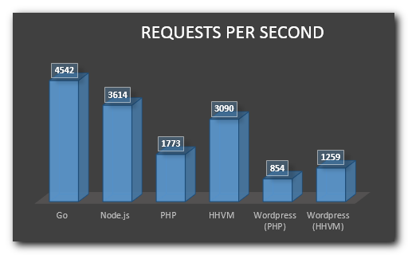
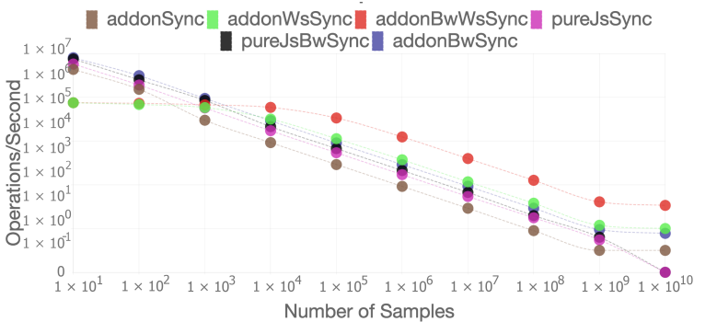
Figure 1. Average operations per second of synchronous implementations in Node.js
Performance Advantages on Unix Systems. Part 2
Figure 2. Benchmark comparison for request per second handling capability for different back-end solutions

Slide 12

Security
Security
Process isolation: Clustering forks multiple worker processes; crashes or breaches in one don't affect others, boosting reliability on Unix.
Sandboxing: VM module runs untrusted code in isolated contexts, blocking access to global scope and limiting malicious damage.
Privilege limitation: Drops root privileges after binding ports, running as low-privilege user to reduce exploit risks.
Mitigation: Object.freeze seals prototypes, stopping attackers from injecting properties that cause DoS or code execution.
DoS resistance: Asynchronous event loop keeps server responsive, preventing slow clients from blocking or exhausting resources.
Error handling: Domains and try-catch group async operations, catching errors centrally to avoid process crashes.

Slide 13




Current limitations
Weaknesses
Integrations/Research
Competition
Current limitations
Single-threaded model creates CPU bottlenecks for intensive tasks; callback complexity ("callback hell") complicates code readability and maintenance in large applications.
Rust and WebAssembly integrations enable hybrid apps, significantly boosting CPU-bound performance beyond pure JavaScript limitations (Kyriakou, 2022).
Deno provides secure-by-default permissions and native TypeScript; Bun delivers superior startup speed and built-in tooling, challenging Node.js in performance and developer experience.

Slide 14

Table of references
References
[1] Welsh, M., Culler, D., & Brewer, E. “SEDA: An Architecture for Well-Conditioned, Scalable Internet Services.”, 2001: https://www.sosp.org/2001/papers/welsh.pdf
[2] von Behren, R., Condit, J., & Brewer, E. “Why Events Are a Bad Idea (for High-Concurrency Servers.” Proceedings of the 9th Workshop on Hot Topics in Operating Systems (HotOS), 2003: http://bantha.org/~jcondit/threads-hotos-2003.pdf
[3] Pai, V. S., Druschel, P., & Zwaenepoel, W. “Flash: An Efficient and Portable Web Server.” Proceedings of the USENIX Annual Technical Conference (ATC), 1999: https://www.usenix.org/legacy/event/usenix99/full_papers/pai/pai.pdf
[4] Tilkov, S., & Vinoski, S. “Node.js: Using JavaScript to Build High-Performance Network Programs.” IEEE Internet Computing, 14(6), 80-83, 2010: https://www.scribd.com/document/948489121/0-Node-js-Using-JavaScript-to-Build-High-Performance-Network-Programs
[5] Lei, Y., Liu, J., Yu, Q., & Cao, B. “Performance Comparison and Evaluation of Web Development Technologies in PHP, Python, and Node.js.” Proceedings of the IEEE 17th International Conference on Computational Science and Engineering (CSE), 2014: https://www.researchgate.net/publication/286594024_Performance_Comparison_and_Evaluation_of_Web_Development_Technologies_in_PHP_Python_and_Nodejs
[6] Kyriakou, K. I. D., & Tselikas, N. D. “Complementing JavaScript in High-Performance Node.js and Web Applications with Rust and WebAssembly.” Electronics, 11(19), 3217, 2022: https://www.mdpi.com/2079-9292/11/19/3217
[7] Koishybayev, I., & Kapravelos, A. “Mininode: Reducing the Attack Surface of Node.js Applications.” Proceedings of the 23rd International Symposium on Research in Attacks, Intrusions and Defenses (RAID), 2020: https://www.usenix.org/system/files/raid20-koishybayev.pdf
[8] Li, S., Kang, M., Hou, J., & Cao, Y. “Mining Node.js Vulnerabilities via Object Dependence Graph and Query.” Proceedings of the 31st USENIX Security Symposium (USENIX Security), 2022: https://www.usenix.org/system/files/sec22summer_li-song.pdf

Slide 15
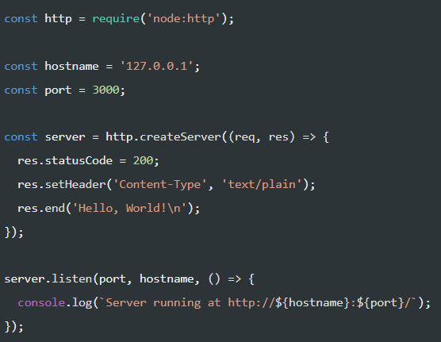
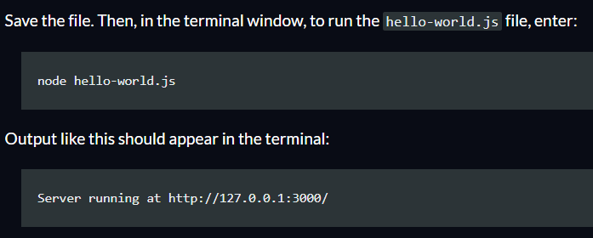
Example (server code)
Examples

Slide 16
Thank you
Nikita Niakhai/M25-SNE-01/Unix-based Applications
Do you have any questions?
Node.js as Unix-based Application:
Evolution, Architecture, Performance, Security

